Slide 1
User Interface Design 7 ±2 Rules of Thumb for Better User Interfaces¹
John “Scooter” Morris, Ph.D., UCSF
¹Appologies to George Miller

Slide 2
Why am I here?
I am not a user interface designer
Primarily a software developer/researcher
Project manager for UCSF Chimera
Cytoscape core team member
Developer of several Cytoscape plugins
Many have significant UI or visualization components
I have been associated with the HCI (human-computer interaction) community for ~25 years
For some reason, the organizers asked…

Slide 3
Organizer Specification
Motivate audience that user interfaces are important
Provide a background in the theory and practice of human-computer interaction
Give lots of examples of good and bad user interfaces…
…do it in 20 minutes so there’s lots of time for questions

Slide 4
My Interpretation
Motivate audience (I hope?)
Provide some rules of thumb to help with the design and repair of user interfaces
Provide some examples
Do it in 25 minutes so there’s time for a couple of questions

Slide 5
Motivation
How many of you write software used by other people?
How many of you use software used by other people?
How many of you sometimes curse at software and the fool that wrote it?
How many of those fools are in this room???
… don’t be a fool – make your software usable!!

Slide 6
Further Motivation
Heard in the hallway at UCSF…
“We get all these dumb questions on the [chimera-help, cytoscape-help, …-help] mailing list. Why don’t users just read the documentation?”
The more usable your software, the fewer questions you’ll have to answer.
How many of us would be willing to include our home phone number with our software??

Slide 7
User Interface Design
Goal:
Design software that:
does what it is supposed to do,
does it efficiently,
in the way the user expects,
with an appropriate amount of training.

Slide 8
Designing Good User Interfaces is Easy
Spend significant time with users
Understand their tasks, and the context of their tasks
Spend significant time developing prototypes and passing those prototypes by your users
Iterate
Write software, following all good UI design principals (where they conflict, ask users)
Do extensive user testing with a broad sampling of your target population
Correct usability errors found in software.
Document software, deploy it, and train users
Iterate, correcting usability errors found after deployment

Slide 9
Designing Good User Interfaces is Easy
Look for new job
Research has moved on, software no longer relevant.
Employer, PI, Thesis Advisor suggests another line of work…

Slide 10
Rules of Thumb
A rule of thumb is a principle with broad application that is not intended to be strictly accurate or reliable for every situation.
-- Wikipedia

Slide 11
Rules of Thumb
Know your users
Easy things should be easy
Be consistent
Avoid jargon
Don’t make users think about the interface
Let the user be in control
Bugs are a usability problem
Graphical design is important

Slide 12
Rule #1 – Know your users
The User Centered Design dictum
What tasks are they trying to accomplish?
Where does your software fit into their overall workflow?
What terms would they use for objects and actions in your system?
Corollary 1: You are not your user
No matter how well we identify with users of our software – they didn’t write it and don’t know the internals of the system.

Slide 13
Rule #1 – Know your users
Corollary 2: Involve users in the change process
If you have a good idea for improving your UI, try it out on some colleagues and close collaborators.
If you have a GREAT, NOVEL idea for improving your UI….
…Try it out on lots of colleagues and users!

Slide 14
Rule #1 – How?
How to get to know your users
Existing software:
Watch them using your system (don’t help, watch)
Teach training classes
Monitor help e-mail
Write tutorials
New software:
Talk with users
Use low-fidelity prototypes
Fancy term for paper sketches, powerpoint, etc.

Slide 15
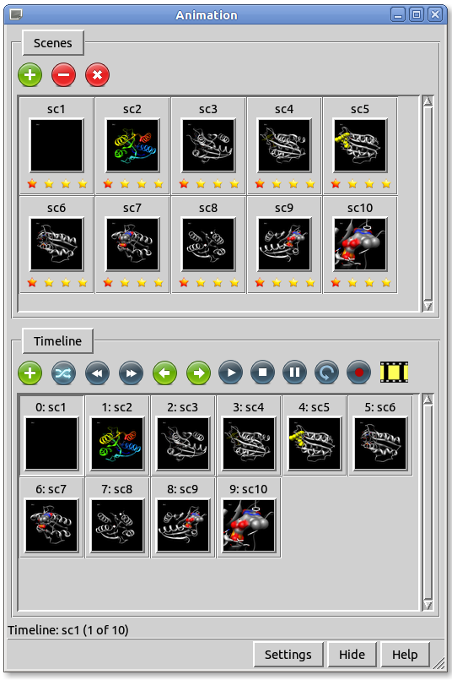
Rule #1 - Example
Example: UCSF Chimera Animation Interface
Goal: Allow users to create simple animations by interpolating between scenes (key frames).
Requirements:
Way to create and manage scenes
Way to put scenes together to create animation
Want to control # of frames
What to interpolate
May want to add special transitions between key frames
Notes:
Problems
Timeline doesn’t look like a timeline
No easy way to add intermediate transitions
Visualization of progress very difficult to make sense
Clear once we saw it that the interface didn’t meet the needs

Slide 16
Rule #1 - Example 2
GenMAPP/CS
Goal: Replacement for GenMAPP based on Cytoscape
Requirements:
Optimize for GenMAPP workflow
Provide access to Cytoscape functionality
Utilize Cytoscape UI and mechanism whenever possible

Slide 18
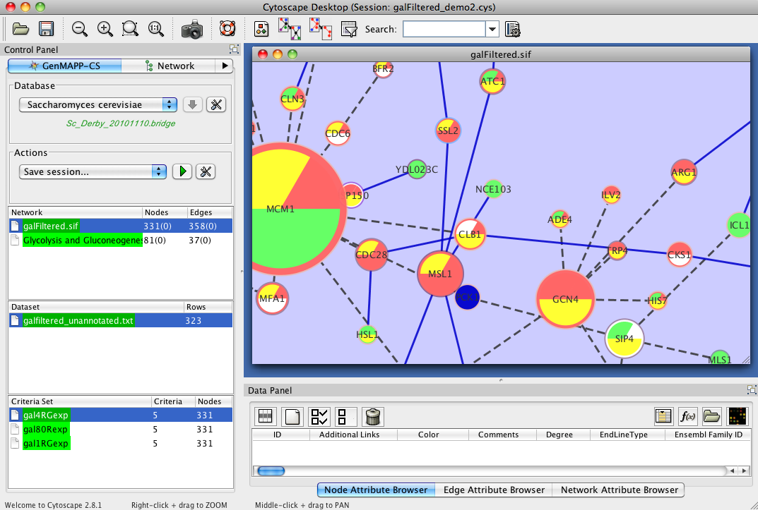

Slide 19
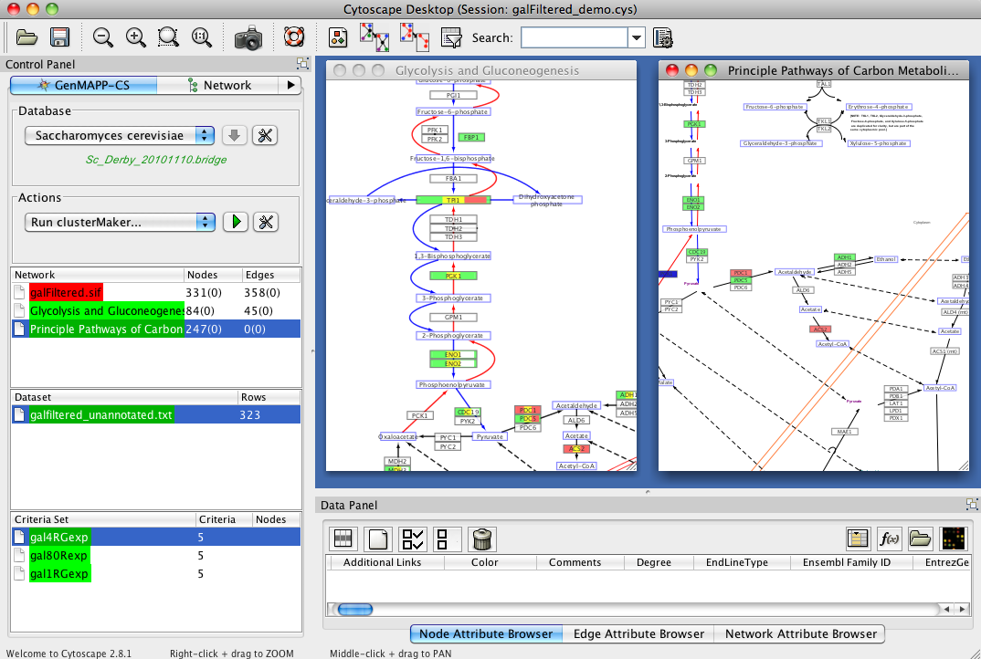

Slide 20
Rule #2 – Easy things should be easy
Easy things should be easy, but
Difficult things should be possible
“Easy things” should be interpreted as
Central to the user’s task or workflow, or
Common operations
Implication
Don’t “hide” common functions in long menu lists
Use “progressive disclosure” to provide less common options or functions

Slide 21
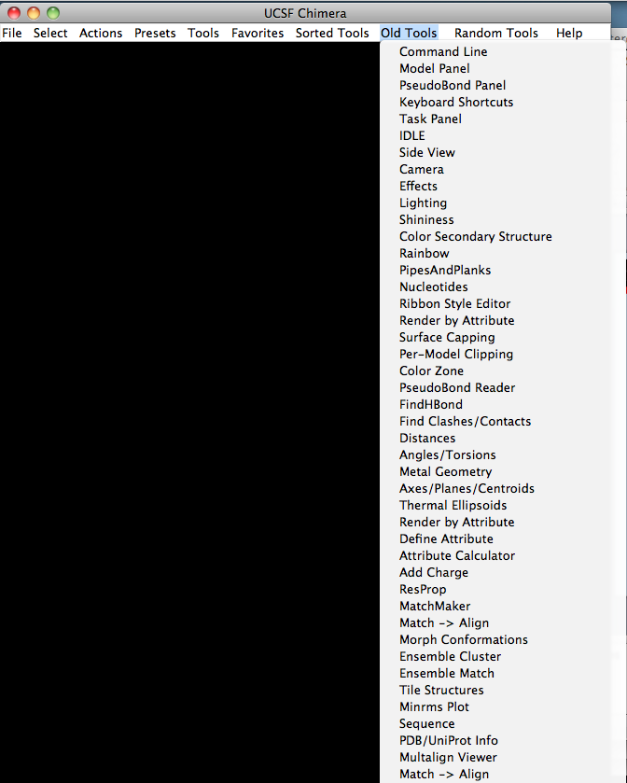
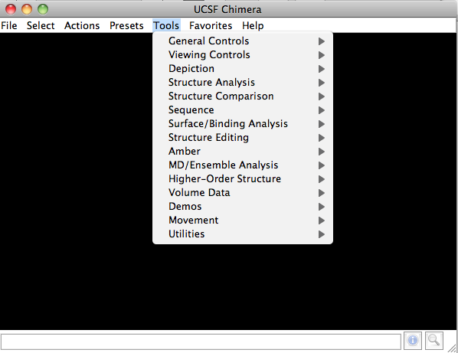
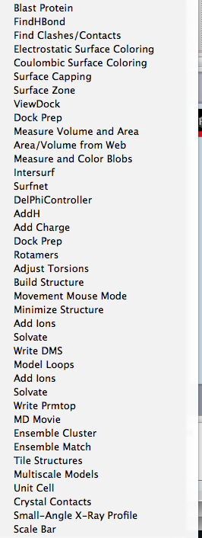
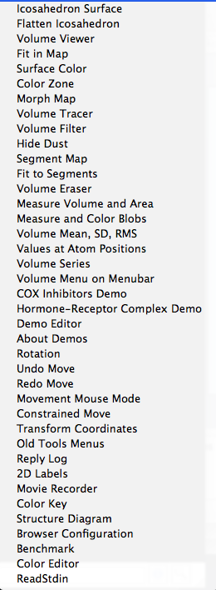
Rule #2 Example
UCSF Chimera’s Tool menu
Chimera extensions add menus to the “Tools” menu
Several years ago realized things were getting too long
Reorganized menu functionally

Slide 22
Rule #3 – Be Consistent
Within your application
terminology, interaction, etc.
Within the platform
can be hard for multiplatform applications
“Normal” GUI expectations
Dialogs can be canceled (and their actions undone)
Radio buttons are one-of-many (one must always be selected)
Checkboxes are always on/off
Etc.
Notes:
Skip

Slide 23
Rule #4 – Avoid Jargon
Use user’s terminology, not the program’s (or yours)
Avoid Computerease
Don’t let program information leak to the user
e.g. no Blue-Screen of Death (BSOD), Java stack traces, etc.
Catch them (whenever possible) into a log for debugging
Use user task terminology in menus, labels, prompts
May take some interaction:
Developer: “What would you call this?”
User: “The handle thing?”
Developer: “Exactly. Note to self: a pivot point thumb is a handle”
Notes:
Skip

Slide 24
Rule #5 – Don’t Make Users Think
…about the User Interface
Avoid ambiguity
…in labels (what does OK mean?)
…in the way things are grouped (does this label go with the text field to the left, or the text field above it?)
Minimize searching for commands or actions
Progressive disclosure can help here, too
Don’t allow dead-ends
Only one choice and not the one the user wants
Don’t substitute text or tooltips for good design
Users don’t read instructions…
…in case you haven’t noticed
…you probably don’t either

Slide 25
Rule #6 – Let the User be in Control
User’s think of the screen as their own.
Mouse warping is disconcerting
May seem “efficient”, but doesn’t help if it freezes the user
Tabbed interfaces can be problematic
Too many tabs require reorganization. Forces user to find things again.
Use modal dialogs sparingly
Don’t restrict window sizes
Put windows that might get large in scrolling panes
Long running tasks need a Cancel
And an estimate of how long running it might be
Notes:
Skip

Slide 26
Rule #7 – Bugs are a Usability Problem
The best user interface can’t overcome buggy software.
If the software crashes, throws exceptions, or gives spurious results, it’s clearly not doing what it’s supposed to do, and not doing what the user expects.
(if your users have come to expect exceptions and spurious results, you have other problems…)
So, if your feeling about all this UI stuff is that it’s the algorithm that matters…
… you’re right, but…

Slide 27
Rule #7 – Bugs are a Usability Problem
The most robust software can’t overcome a bad user interface.
If a user can’t figure out how to use it, it doesn’t matter how great the algorithm is.
Notes:
…In case of confusion, here’s my home phone number???

Slide 28
Bonus Rule #8 – Graphical Design is Important
But, unless you are a graphical designer...
Keep it simple…
Stay away from too much color in your interface
Red-Green color blindness effects 7-10% of males
Care to guess the most common colors for heat maps?
Be very careful with icons: are they cute, or meaningful?
Recognition is better than recall, but
Icons need to be recognizable

Slide 29
Rules of Thumb
Know your users
Easy things should be easy
Be consistent
Avoid Jargon
Don’t Make User’s Think about the Interface
Let the User be in Control
Bugs are a usability problem
Graphical design is important

Slide 30
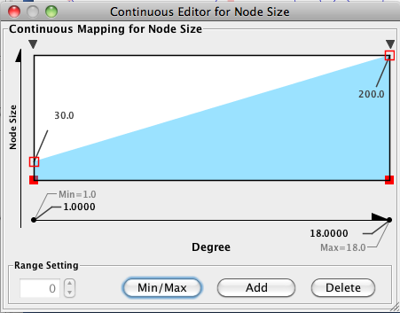
Detailed Example
Cytoscape Continuous Mapper

Slide 31
Conclusions
If our collaborators, colleagues and other users matter, the user interface matters
We can use simple rules to improve the user interface of our software
We need to keep the user in mind
User-centered design
Occasionally, validate interface with users
Just like we test our software, we need to test our interfaces
Prototypes can be really helpful, here
We can build more usable software

Slide 32
Design Guidelines
Shneiderman and Plaisant (2009)
Strive for consistency
Cater to universal usability
Offer informative feedback
Design task flows to yield closure
Prevent errors
Permit easy reversal of actions
Make users feel they are in control
Minimize short-term memory load

Slide 33
Design Guidelines
Nielsen and Molich (1990)
Consistency and standards
Visibility of system status
Match between system and real world
User control and freedom
Error prevention
Recognition rather than recall
Flexiblity and efficiency of use
Aesthetic and minimalist design
Help users recognize, diagnose, and recover from errors
Provide online documentation and help

Slide 34
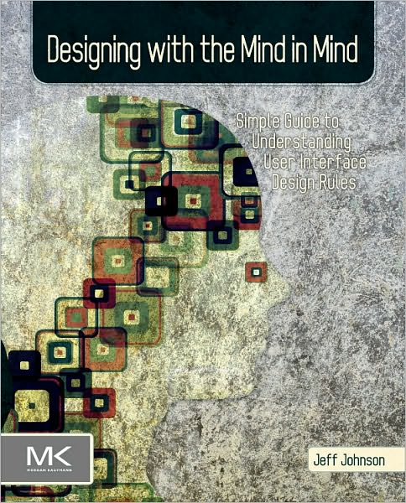
References
The Design of Everyday Things,
Donald Norman
Designing the User Interface,
Ben Shneiderman, Catherine Plaisant
Designing with the Mind in Mind,
Jeff Johnson

Slide 35
References
http://www.gui-bloopers.com/checklist.php

Slide 36
References
Annual CHI Conference
Sponsored by ACM/SIGCHI
Theory and practice of HCI
CHI 2012 May 5-10, Austin, TX, USA
CHI 2013 April 27-May 2, Paris, FR
CHI 2014 April 26-May 1, Toronto, CA
CHI 2015 Asia

Slide 37
Thanks!
Questions?

